Slide 1
Operating System (OS)
Name - Shendre Samarth Manish
Department – First year second semester
Subject – BCC (Business Communication using Computers)
Assignment – Assignment no 7 (Presentation on technical topic)

Slide 2
Topics
Introduction
History
Examples of Operating Systems
Advantages of Operating systems
Disadvantages of Operating systems
Conclusion

Slide 3
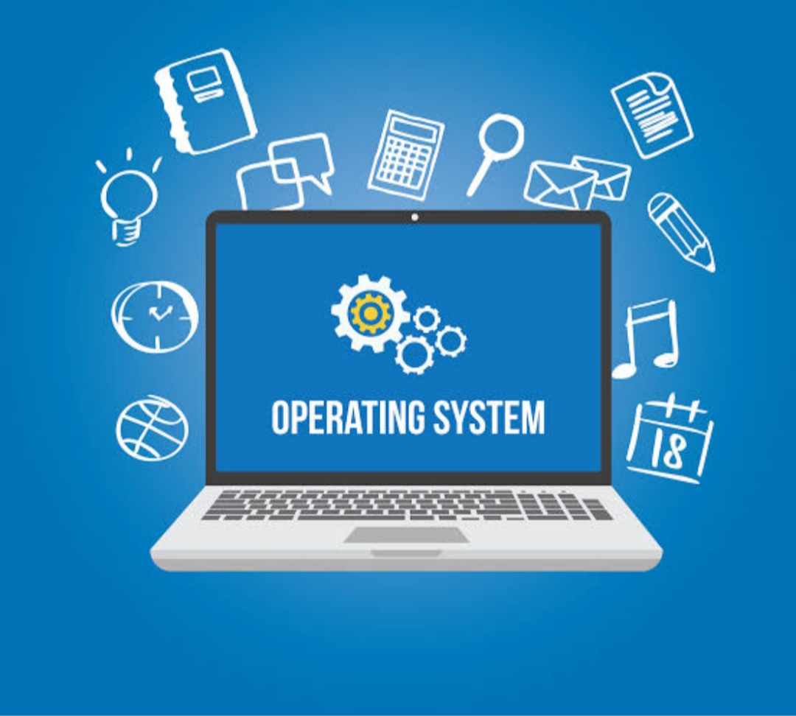
Introduction
Operating System
An operating system (OS) is system software that manages computer hardware, software resources, and provides common services for computer programs. Time-sharing operating systems schedule tasks for efficient use of the system and may also include accounting software for cost allocation of processor time, mass storage, printing, and other resources. For hardware functions such as input and output and memory allocation, the operating system acts as an intermediary between programs and the computer hardware,[1][2] although the application code is usually executed directly by the hardware and frequently makes system calls to an OS function or is interrupted by it. Operating systems are found on many devices that contain a computer – from cellular phones and video game consoles to web servers and supercomputers.

Slide 4
History of Operating System (OS)
The first operating system was introduced in the early 1950's, it was called GMOS and was created by General Motors for IBM's machine the 701. Operating systems in the 1950's were called single-stream batch processing systems because the data was submitted in groups.
Microsoft created the first window operating system in 1975. After introducing the Microsoft Windows OS, Bill Gates and Paul Allen had the vision to take personal computers to the next level. ... They named the operating system Macintosh OS or Mac OS.

Slide 5
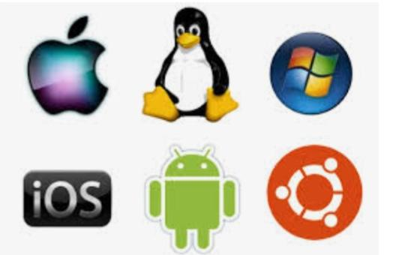
Popular Icons of Operating System

Slide 6
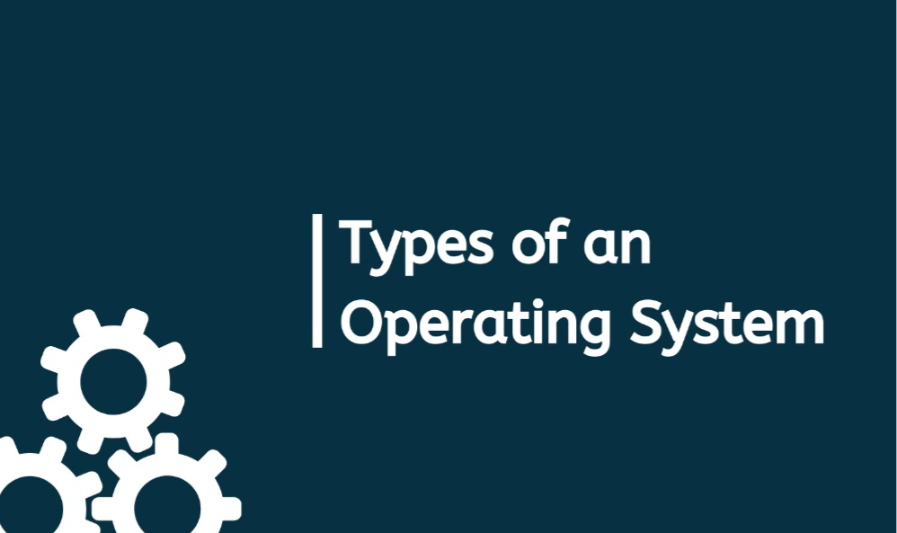

Slide 7
Types of Operating System
1. Batch Operating System 2. Time-Sharing Operating System 3. Distributed Operating System 4. Embedded Operating System

Slide 8
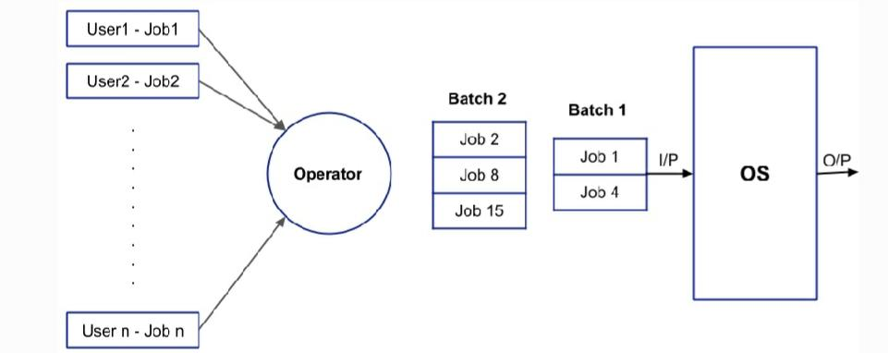
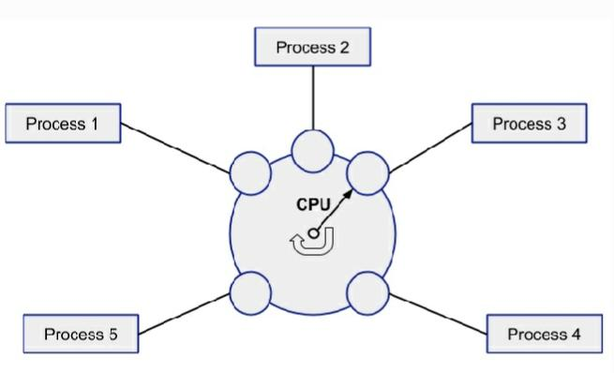
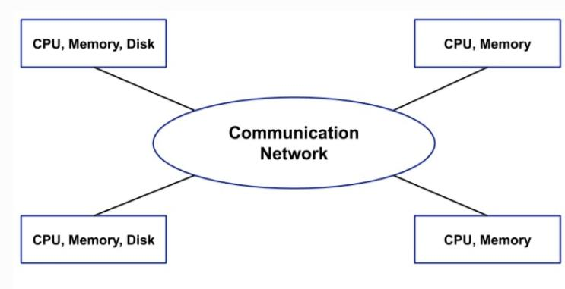
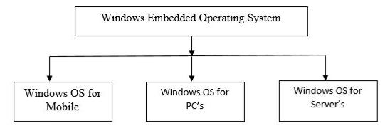
Block Diagrams of Types of Operating System

Slide 9
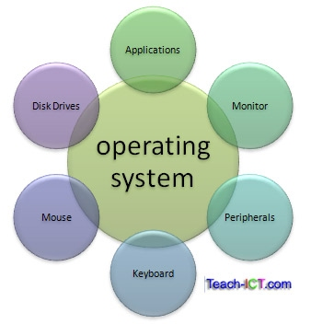
Pictorial Representation of Operating System

Slide 10
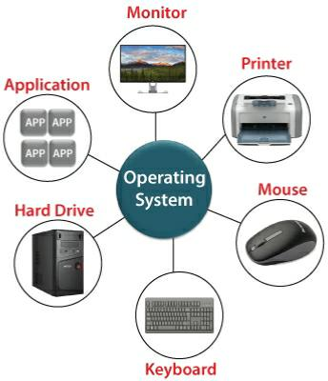
Operating System is used at which Places

Slide 11
Advantages of Operating System
1) OS Provides Graphical User Interface (GUI) in the form of menu, icons, and buttons. 2)OS manage the memory by memory management techniques. e.g, paging, swapping, Read More segmentation Read More etc. 3)OS manage the input and output. All I/O devices are managed by OS.

Slide 12
Disadvantages of Operating System
1) It has broadened memory access times, for example, page table query. 2) Need improvement with utilizing TLB. 3) Required protected page tables. Need more memory for memory board. 4) Need inner fracture. 5) Page Table Length Register (PTLR) needs to bound with virtual memory size. 6) It required greater improvement in staggered page tables and variable page sizes.

Slide 13
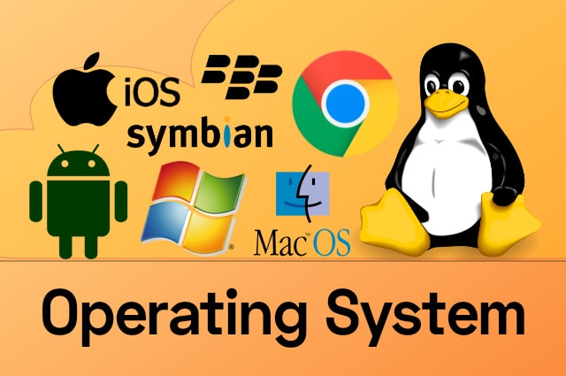
Examples of Operating System

Slide 14
Conclusion
From this Project of Operating System we came to know about the various types of operating system and we also get to know about the Operating we came to know that what is Operating system? Examples of Operating System also we came to know the Advantages and Disadvantages of Operating Systems We also understand that What are the limitations of the Operating system The Case study if this project not only help us to get the detailed knowledge of Operating System and it becomes easier to us to understand the history of Operating System that where it was orignated? As well as we came to know about the block diagram and pictorial Representation of Operating Systems

Slide 15


